Slide 1

Git and GitHub: Version Control for Everyone
Let's learn about Git and GitHub! We'll cover version control, why it's important for coding, and how Git and GitHub help developers work together.

Slide 2


What is Git?
Distributed Version Control
Linus Torvalds' Creation
Developed by Linus Torvalds, the creator of Linux, in 2005, Git focuses on speed, data integrity, and non-linear workflows.
Git is a distributed version control system that tracks changes to files locally, allowing you to revert to previous versions, compare changes over time, and branch out for parallel development.

Slide 3


What is GitHub?
Centralized Repository
GitHub is a web-based platform that uses Git for version control, providing a centralized repository for code, issues, and collaboration tools.
Social Coding and Beyond
GitHub fosters social coding, enabling pull requests, code review, project management, and knowledge sharing.

Slide 4
Git and GitHub Applications
Software Development
Web Development
Data Science
Documentation
Tracking changes to HTML, CSS, JavaScript, and other web assets.
Versioning data sets, machine learning models, and analysis scripts.
Maintaining versioned documentation for software, APIs, and products.
Managing source code, tracking features, bug fixes, and releases.

Slide 5
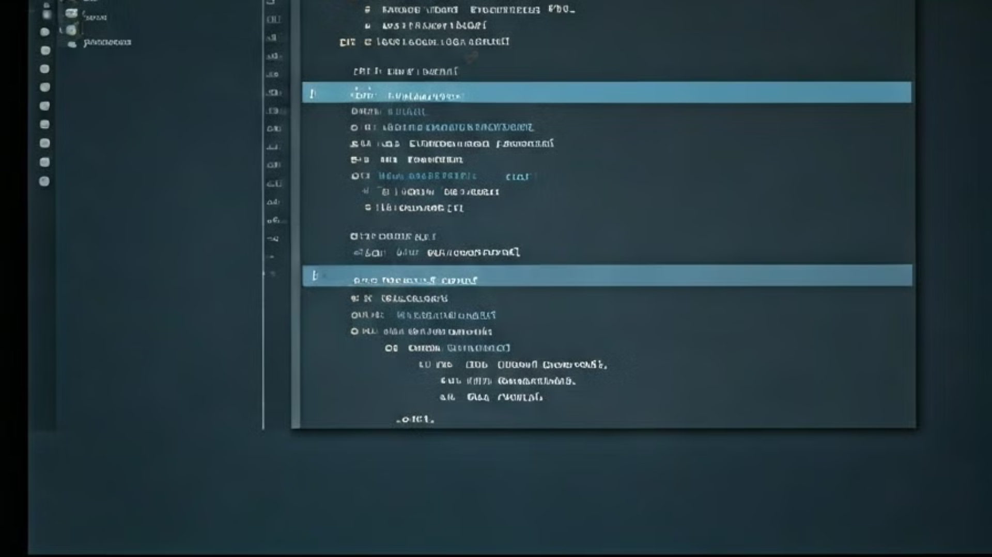




Core Git Commands: The Fundamentals
git init
git clone
git add
git commit
Creates a new Git repository.
Copies a repository from a remote URL (e.g., GitHub).
Stages changes for commit.
Records changes with a message.

Slide 6

git push
Uploads local changes to a remote repository.
Pushing Changes
Synchronization
Sends committed changes from your local branch to the remote repository.
Keeps your local repository in sync with the remote repository.

Slide 7

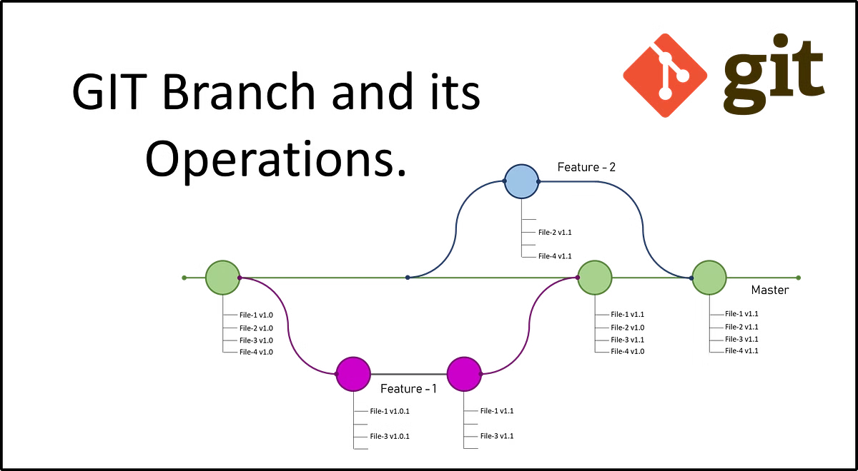
Branching and Merging: Managing Parallel Development
1
git branch
Creates, lists, or deletes branches.
2
git checkout
Switches between branches.
3
git merge
Combines changes from one branch into another.
4
git rebase
Integrates changes by replaying commits.

Slide 8

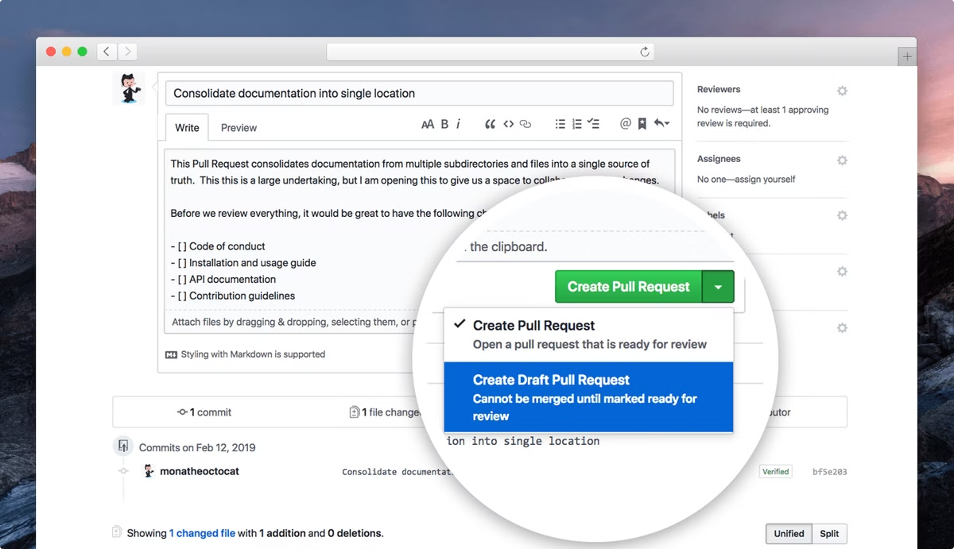



Collaboration with GitHub: Pull Requests and Code Review
Pull Requests
Propose changes to a repository.
Code Review
Review code changes before merging.
GitHub's Interface
Facilitates discussion, feedback, and approval.

Slide 9

Conclusion: Git and GitHub are Your Friends
Git and GitHub are powerful tools for developers, enabling collaboration, code management, and building better software. Explore their features and start using them for your projects!

